Slide 1
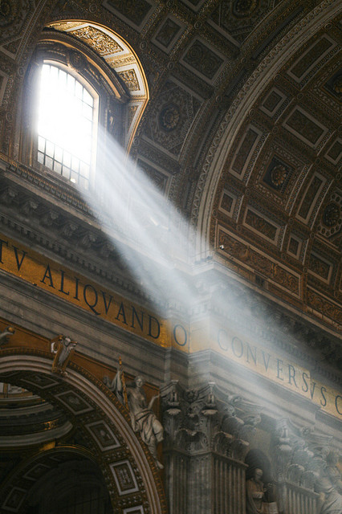
Theological Basics
God and Man,
Jesus and Church,
Tradition and Scripture

Slide 2
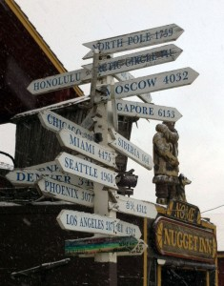
Logistics
Bathrooms and Fountains
Timing
Handouts
Questions
Introductions

Slide 3
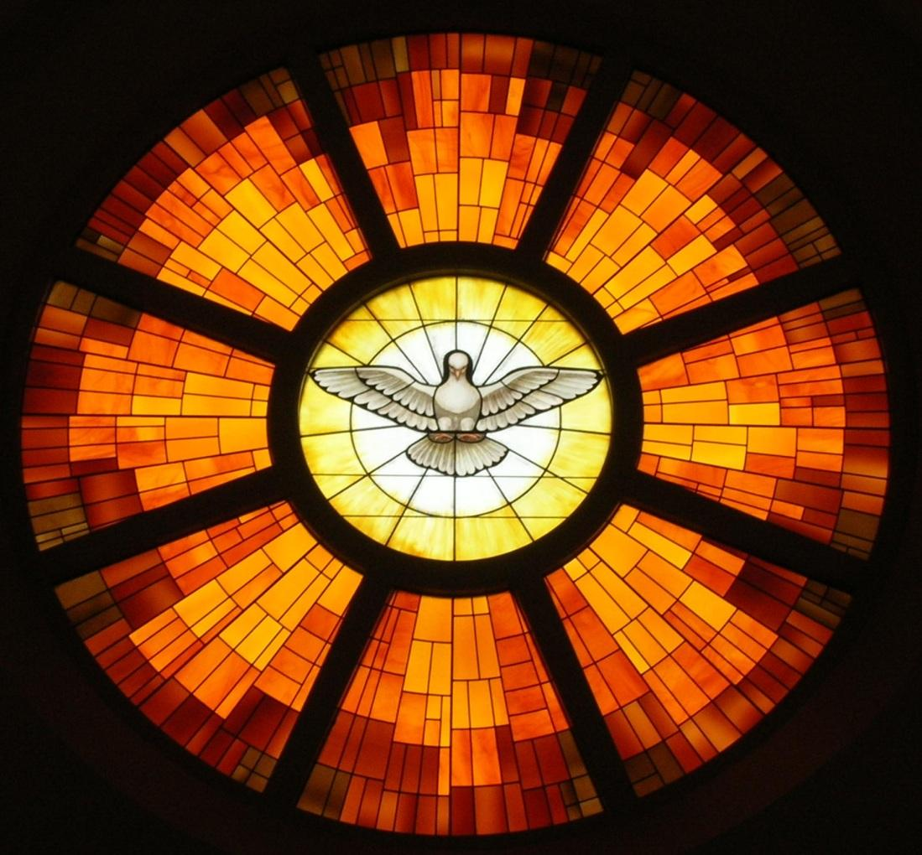
BEGIN WITH Prayer…
Come Holy Spirit, fill the hearts of your faithful and kindle in them the fire of your love. Send forth your Spirit and they shall be created. And You shall renew the face of the earth.
O, God, who by the light of the Holy Spirit, did instruct the hearts of the faithful, grant that by the power of the Holy Spirit we may be truly wise and courageous and ever enjoy His consolations. Through Christ Our Lord.
Amen.

Slide 4
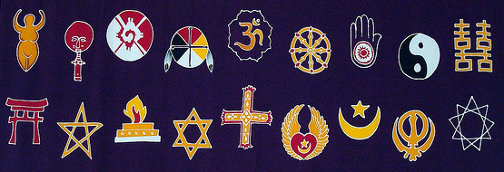
THE Unique Gospel of Jesus, The Christ
Notes:
Today in America, Catholics face a bewildering number of alternative views on faith and spirituality. On one hand, “secular humanism” and unvarnished atheism pervade in our academic institutions and our media -- confronting and confounding ill-equipped Catholics on fundamental issues. On the other hand, New Age paganism and Eastern spirituality gently ease their way into Christianity and specifically Catholicism, distorting and undermining the Gospel message of love through Christ. Even among Christian and pseudo-Christian groups, the understanding of God is contorted. For example, LDS (Mormon) and Jehovah’s Witness theology denies the Trinity including Christ’s divinity and resurrection. Fortunately for us, none of these philosophies are new and all have been dealt with at one time or another by the Church in the last 2,000 years. A well-equipped Catholic has everything he or she needs to navigate these murky waters. The reality of the Gospel -- God and His saving plan through Christ -- is a unique message in human history. Some say God doesn’t exist, but He does. Some say God is distant, but he is really present in the tabernacle and has given us the Eucharist so that we may commune with Him in the most intimate way. Some say God is a manipulative, angry, or vindictive, but He’s consistent, unconditional in His love, and always ready to forgive a repentant heart. Some say God asks too much and gives too little, but He asks no more than you would ask of your own spouse or child and He has given us everything we have and more than we could imagine in eternal life. Some say God is confusing or contradictory, but He has given us a Church and a Tradition in Word and Scripture so that we might understand His will for us. This week, we will cover the proper, Catholic understanding of God, His nature, His revelation of Himself to us, and the Church he established to guide us through the ages. We’ll equip you to understand how faith in God is not just reasonable, it’s the only reason and rationale that stands up to the test. We’ll cover how God has revealed Himself in Jesus, through the Church, and through Scripture.

Slide 5
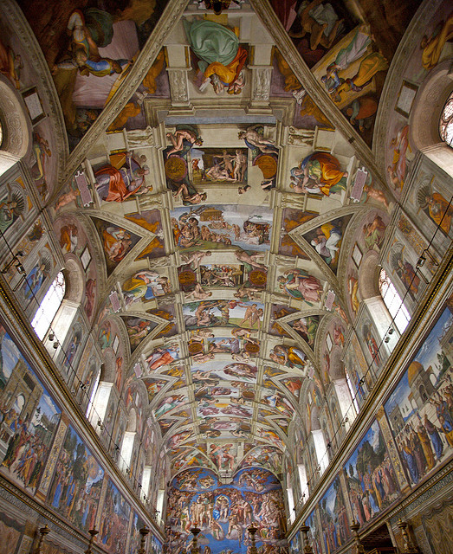
What IS GOD? Who is God?
Notes:
“In the beginning God” (Gen 1:1)
Doesn’t just exist, but is existence itself; substance itself, cannot be broken down
There never was a time when God wasn’t; he isn’t just eternal, but infinite
God is not a thing. He is the creator of all things
God is the simplest and most complete answer to the most foundational and pressing questions of every human: Where did I come from? What is my purpose? Where am I going? (God; to know love and serve Him; eternal life with Him in Heaven)
“If God does not exist, then everything is permissible.” - Dostoevsky (famous Russian Orthodox philosopher)
What if God didn’t exist? – Survival of the Fittest, Utilitarianism – “Thought” and free will: illusions
Evolution of denial of God: Village atheist “There is no God”, Enlightenment Deism “God exists, but has hit the road”, Modernist (Nietzsche) “God is dead”, post-Modernist “There is no God” village atheism now with books and “science” as an excuse not to have faith and use reason (e.g. “Scientism”).

Slide 6
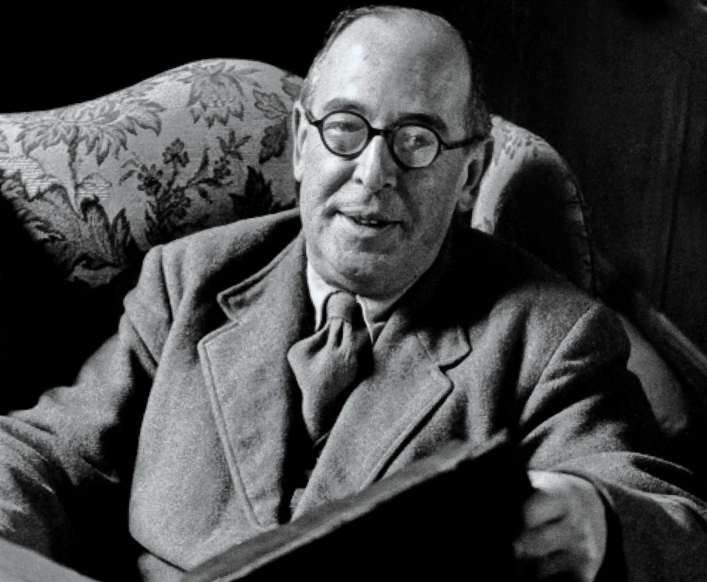
“My argument against God was that the universe seemed so cruel and unjust. But how had I got this idea of just and unjust? A man does not call a line crooked unless he has some idea of a straight line. What was I comparing this universe with when I called it unjust?”
C.S. Lewis, Mere Christianity
Notes:
C.S. Lewis, the famous author, was atheist, but converted and wrote a fantastic book: Mere Christianity. In this book he explains his conversion of thought and why he now believes.
He presents several proofs for the existence of God from mere human knowledge and reason. He was not the first, though. Plato and Aristotle both had many proofs for the existence of God and many more people have developed others over the millennia

Slide 7
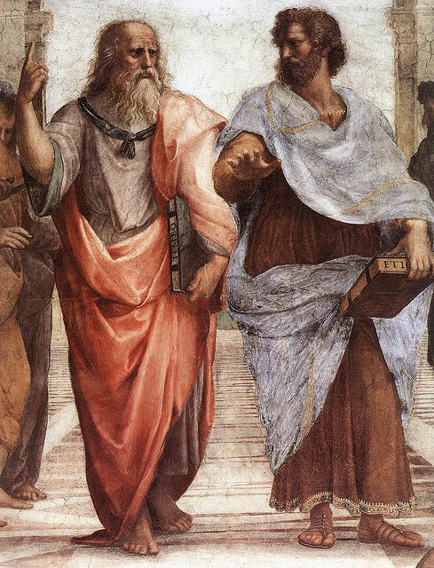
KNOWLEDGE OF THE EXISTENCE of God
8 Arguments for God’s Existence
Nature
“Perfection”
Change
Causation
Time and Contingency
Morality
Art & Beauty
Desire for Joy & Happiness
Notes:
Nature: “The survival of the fit presupposes the arrival of the fit” (Peter Kreeft)
Perfection: “Goodness” and “Badness”, degrees of perfection implies an ultimate gauge by which we can judge “good” or “bad” He is infinite, perfect, and good which can all be deduced from his self-existence (Aristotle, Aquinas)
Change: If everything is in motion and changes, there must have been a “prime mover”, an “unchanging cause of change” (Aristotle)
Causation: To exist implies a cause, the universe exists, therefore it must have a cause (Kalam).
Time and Contingency: Existence of anything implies the existence of its source material, everything ultimately depends on the existence of space and time, therefore there must be something upon which space and time rely for existence that exists and which is not contingent upon anything else (Argument from Contingency)
Morality: We have a sense of morality. Morality requires an objective basis and cannot be explained by pure physiology
Art and Beauty: that humans can conceive and perceive the artistic value and beauty in things (including nature) cannot adequately be accounted for by purely biological explanations
Joy and Happiness: “yearning” for something we haven’t experienced and can’t fully explain (i.e. God) cannot be explained physiologically

Slide 8
"If I find in myself a desire which no experience in this world can satisfy, the most probable explanation is that I was made for another world."
~ C.S. Lewis, Mere Christianity

Slide 9
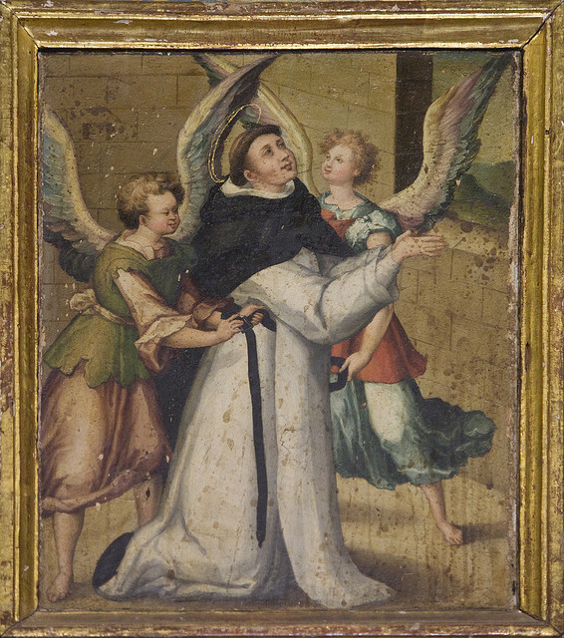
KNOWLEDGE OF ATTRIBUTES of God
8 Attributes of God Known by Reason Alone
Unknowable in the true sense
Not a “thing”
Infinite
Singular (unique)
Simple
Perfect
Good
Intellect and Will (Personality)
Notes:
Unknowable: God is unknowable in the true sense, all our knowledge is merely based on analogies
Not a Thing: He is not a creature, a “thing”, or a higher/glorified thing. He depends on no other things for His existence
Infinite: He is infinite, no beginning, no end. Not just external, but infinite
Singular: unique, there aren’t other copies of Him, predecessors, or successors
Simple: substance itself, not comprised of smaller parts, cannot deconstruct or dissect “our God is one LORD”
Perfect: Lacking in nothing, requiring nothing, ultimately efficient in action (“pure act”), all that He can be as they say in the Army. “I am who am” (Divine Name). If he lacked something, then that would imply there must be
Good: Evil is defined as the absence of good (as dark is the absence of light). God is perfect and lacks nothing, therefore God is all good. Good is the highest state of being and God possesses all of it. It is from this yardstick that we can even measure the “goodness” or “badness” of anything
Personality: Not a mindless force of nature, but “pure will” and “pure act” with plans, designs, and intellect

Slide 10
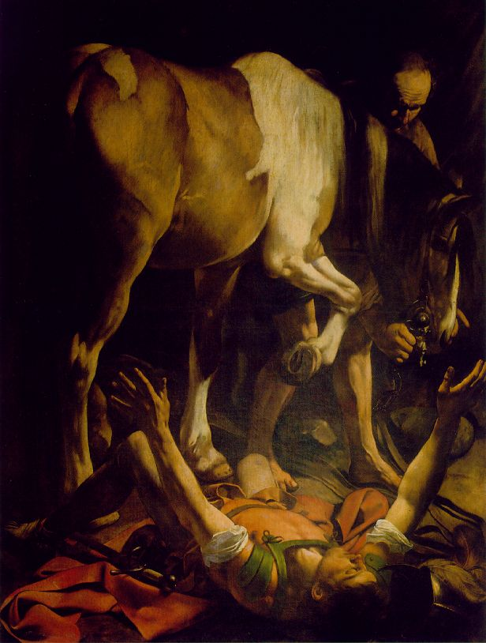
Revealed ATTRIBUTES of God
12 Revealed Attributes of God
Infinitely Eternal (“is, was, is to come”)
Omnipresent/Ubiquitous
Immutable
Simple (no parts; Shema)
Good
Holy
Both Just and Merciful
Love and loving
All-knowing (omniscient)
All-powerful (omnipotent)
Transcendent
Immanent (close, present, available)
Notes:
Infinitely eternal (John 8:58 - “Before Abraham was, I AM”, Revelation 1:4 “is, was, is to come”)
Omnipresent/Ubiquitous: (Heb 1:3;4:12-13, Acts 17:24-28, Eph 1:12, Col 1:16-17, Ps 138:7-12, Job 12:10, etc)
Immutable: "there is no change, nor shadow of alteration" (James 1:17) and several others
Simple: God is one. Simple, no parts. Three persons, distinct, but perfect unity. (Deut 6:4)
Good: wills all to go to Heaven - 1 Tim 4:10; contrary to Calvinism, Islam, some Eastern religions;
Holy: God is Holy, we are made in the image and likeness of God
Just and Merciful: Apparent contradiction - Jesus got the justice, we got the mercy)
Love: He loves all of us and desires our true happiness in Him, with Him, and through Him; 1 Jn 4:8
Omniscient: He knows all Mt 10:30 – he numbers all our hairs
Omnipotent: He is all-powerful, Mt 19:26 – can do anything that is possible
Transcendent: not above, but more-than, everything that is good about us, God is that much better – Is 55:8-9 “For as the heavens are higher than the earth, / so my ways are higher than your ways, / and my thoughts than your thoughts. “
Immanent: not distant, in and among us, present and available – Phil 2:6-8, Luke 3:22 Emmanuel

Slide 11
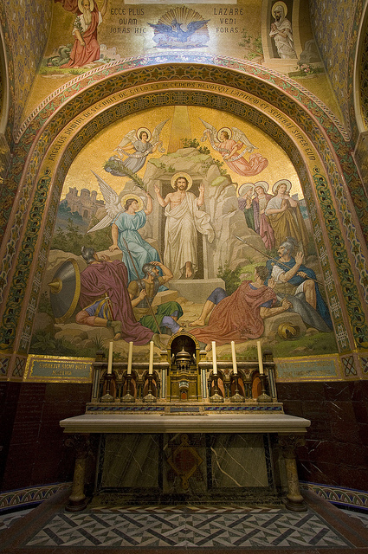
Other facts revealed to us
The name of God
Trinity
Gradual revelation

Slide 12
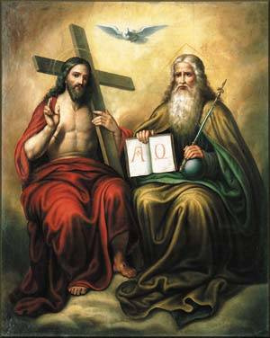
Trinity
One God (Deut 6:4)
Father is God (Jn 5:18)
Son is God (Jn 8:58)
Holy Spirit is God (Mt 28:19)
Distinct persons
Not just names
Or our perspective
Nicene Creed
Notes:
One: Deut 6:4 Shema
Father: John 5:18 “[he] was calling God his own Father, thus making himself equal with God.”
Son: John 8:58 “Truly, truly I say to you, before Abraham was, I am!”
Holy Spirit: Mt 28:19 “baptizing them in the name of the Father and of the Son and of the Holy Spirit,”
Distinct persons: Mt 28:19, Jesus speaks as separate from the Father, the Holy Spirit as separate from Jesus
Not just names: Mt 3:16 – Jesus’ baptism: all three appear at the same time, distinct from one another
Not just our perspective: They appear together at the same time (see above)
Nicene Creed: Formally codified at the Council of Nicea in A.D. 325 from which we get the creed at Mass; to counter the Arian Heresy of Arius a deacon in Alexandria

Slide 13
"And just as Moses lifted up the serpent in the desert, so must the Son of Man be lifted up, so that everyone who believes in him may have eternal life."
For God so loved the world that he gave his only Son, so that everyone who believes in him might not perish but might have eternal life.
- John 3:14-16

Slide 14
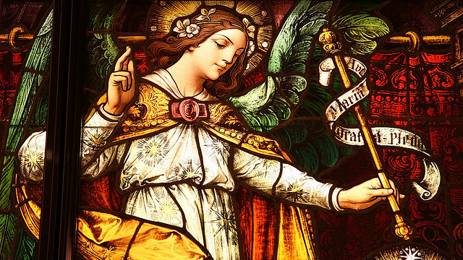
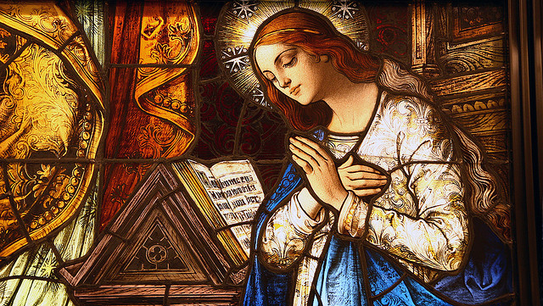
Incarnation
God becomes man
Distinctly Christian doctrine
Not just a ghost
Homoousius / Consubstantial
One spirit, one body, two natures
Hypostatic union
Notes:
God becomes man –Have this mind among yourselves, which was in Christ Jesus, who, though he was in the form of God, did not count equality with God a thing to be grasped, but emptied himself, taking the form of a servant, being born in the likeness of men. And being found in human form he humbled himself and became obedient unto death, even death on a cross. Therefore God has highly exalted him and bestowed on him the name which is above every name, that at the name of Jesus every knee should bow, in heaven and on earth and under the earth
Distinctly Christian doctrine, no other religion has a “God-man” doctrine quite like it -- Separates Christians and non-Christians (i.e. “just a good man”, “just a prophet”, etc)
Not a ghost or apparition (Gnostic Docetism, originated outside of Church)
Of the same substance of God (homoousius; Not Arian homoiousius “similar sub.”)
One spirit, one body, two natures:
Not God and part Man separate in the same body (Nestorian [dyophysite] heresy, rejected in Council of Ephesus in A.D. 431)
Not God and Man fused into a single nature (Monophysite heresy, rejected in Council of Chalcedon A.D. 451)
Hypostatic Union: 100% God, 100% Man, one person, two natures in a mystical “hypostatic union” his divinity felt his humanity and his humanity felt his divinity (finally defined in Council of Constantinople II A.D. 553)

Slide 15
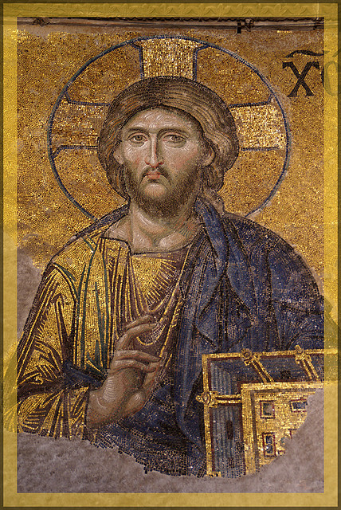
Jesus, the Christ
Jesus: “God Saves”
Christ (Χριστός), Messiah: “Anointed One”
Only person ever pre-announced
Actual historical person
Born around 3-2 B.C.
Fulfilled all the prophecies
Psalm 22 (Suffering Servant)
Isaiah 7:14
Hosea 11:1
Jeremiah 31:15
Isaiah 9:1-2
Notes:
Jesus: “Jesus” means “God Saves”
“Christ/Messiah” means “Annointed One”
Pre-announced: Only person ever pre-announced, OT and even pagan prophecies (note the pagan kings of the east came to adore Christ at the Nativity)
Historical: Real historical figure, archaeological and documentary evidence; More documentary and archaeological evidence for Jesus than for Alexander the Great
Born: Born around 3-2 BC in Bethlehem just south of Jerusalem
Prophesy: Fulfilled all the prophecies (Psalm 22, Isaiah 7:14, Hosea 11:1, Jeremiah 31:15, Isaiah 9:1-2)

Slide 16
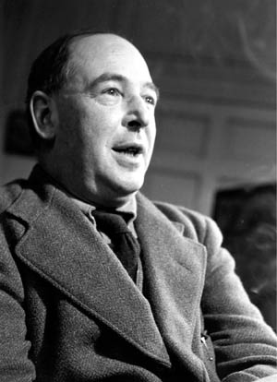
“Either this man was, and is, the Son of God, or else a madman or something worse. You can shut him up for a fool, you can spit at him and kill him as a demon or you can fall at his feet and call him Lord and God, but let us not come with any patronising nonsense about his being a great human teacher. He has not left that open to us. He did not intend to. ... Now it seems to me obvious that He was neither a lunatic nor a fiend: and consequently, however strange or terrifying or unlikely it may seem, I have to accept the view that He was and is God.”
– C.S. Lewis

Slide 17
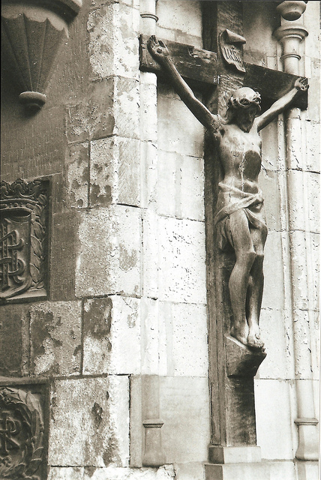
Lord, LIAR, LUNATIC, LEGEND, or GURU?
Trustworthiness
Lord?
Liar?
Lunatic?
Legend?
Guru?
The Resurrection
Notes:
Trustworthiness – everyone agrees that Jesus is a “good teacher” or a “good moral teacher” or even the greatest moral teacher
Lord – He claimed to be Lord, God. You cannot get around this. The Gospels are historically reliable (the most historically reliable of any ancient document)
Liar:
He was morally impeccable in every other way, why would he lie? What would he gain? If a liar, he would be the most clever, cunning, Machiavellian, blasphemously wicked, satanic, deceiver the world has ever known, successfully seducing billions into doing good.
He would’ve been the most accomplished liar and yet utterly a failure (for he died in the end)
The result was everyone behaving much better and conquering the world through love – no liar has ever done anything of the sort
He never would’ve been successful lying to the Jews – they had too many people try and were highly skeptical
Lunatic:
Doesn’t match the psychological profile (practical wisdom, tough love, unpredictable creativity, selflessness, not taking advantage of people)
Lunatics are like darkness, Jesus was like light. He attracted people like no lunatic ever could
No Jew could sincerely think he was God – no other group was less likely to confuse the Creator for the created
The writers of the Gospels certainly weren’t lunatics, No lunatic could’ve invented a single chapter of the Gospels, let alone the whole corpus
Myth:
Texts are highly reliable
Manuscript evidence is very good which high degree of correspondence between disparate manuscripts
Each new manuscript discovered, whether older or newer, adds to the confidence factor, not detracts
Autographs written very early, no chance for mythology to develop when contemporaries are still living
Gospels are not written in mythic style
Four Gospels, not one, with enough story variance to lend credence to eyewitness testimony
Guru:
Cannot ignore his Jewishness
Jesus participated in public liturgy (at Synagogue), which a guru wouldn’t do (they believe in inner spirituality)
For gurus, god is everything and nothing, it is not a separate person
That everything is “one” is enlightenment, “I” is an illusion, consciousness is an illusion
Dalai Lama – Pizza shop “Can you make me one with everything?”
Jesus claimed to be the great “I AM”, which is as far from Eastern religion as you can get
Hindus believe god is unknowable at all, only mystically, but here is Jesus, as a man, claiming to be God
Jesus is searching, bringing people in. Eastern religions believe god is passive, that we must find him.
Remember John 3:16? God *sent* his only Son so that we might…
The Resurrection - The final, undefinable proof: Ultimately reveals Jesus as Lord

Slide 18
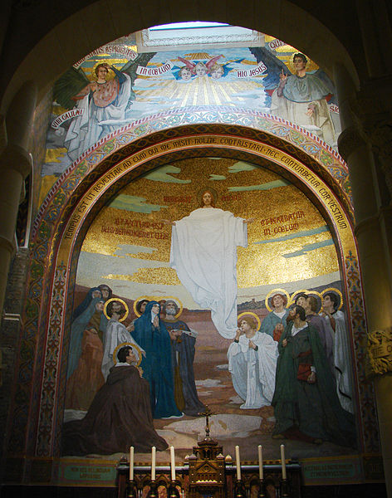
What REMAINS
The Kingdom of God
The Church
The Body of Christ
Notes:
Introduction - Topical slide

Slide 19
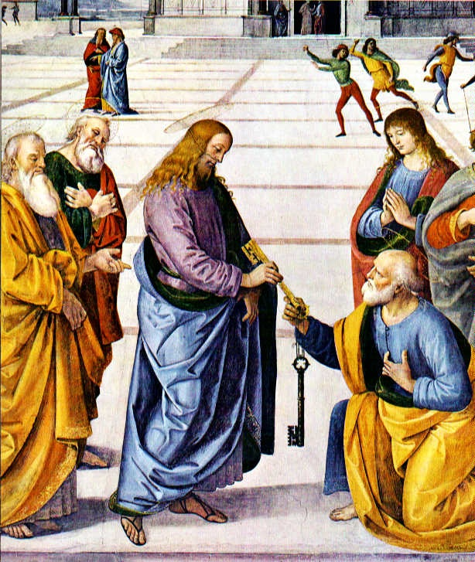
The KINGDOM OF GOD
The Keys
Enigmatic
Signs and Wonders
Holy Spirit – Paraclete
Notes:
The Keys: Christ preached the Kingdom of God and gave the Keys to Peter and the Apostles (Mt 16:18) I will give you the keys of the kingdom of heaven, and whatever you bind on earth shall be bound in heaven, and whatever you loose on earth shall be loosed in heaven
Enigmatic:
Belongs to the poor and lowly – Luke 4:18
revealed to the “little ones” – Matthew 18:6
hidden from the wise and learned – Matthew 11:25
Jesus lives the life of poor and lowly - Matthew 25 (Sheep and Goats)
The first shall be last and the last shall be first – Matthew 20:16
Signs and Wonders:
“Mighty works and wonders and signs” Luke 18:7-23
Pharisees called him the devil
Performed miracles based on faith, to increase people’s faith and belief
Holy Spirit:
Jesus promised us the Holy Spirit to guide the Church and us. (Matthew 16:18)
The Holy Spirit remains and gives us supernatural gifts to help us go about the work of the Kingdom

Slide 20
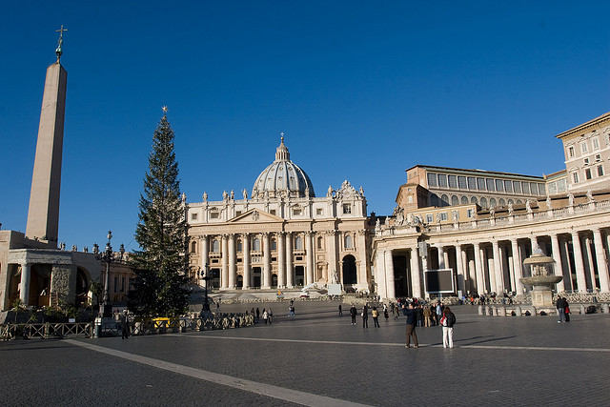
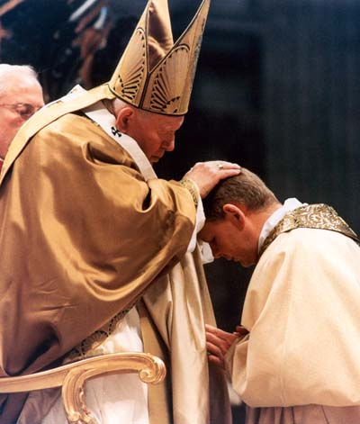
The Church
Continuation of Authority
Mission
One – John 17:21
Holy – Ephesians 5:25
Universal – Matthew 28:19
Apostolic – Ephesians 2:19-20, Luke 10:16
Notes:
Authority: In Matthew 16:18, Peter and the Church were given the keys to the kingdom of heaven and the power to Loose and Bind just like in Isaiah 22:22 – “And I will place on his shoulder the key of the house of David; he shall open, and none shall shut; and he shall shut, and none shall open.” John 20:21-23 – “Jesus said to them again, “Peace be with you. As the Father has sent me, even so I send you.” And when he had said this, he breathed on them, and said to them, “Receive the Holy Spirit. If you forgive the sins of any, they are forgiven; if you retain the sins of any, they are retained.””
Mission: Matthew 28:19 – “Go therefore and make disciples of all nations, baptizing them in the name of the Father and of the Son and of the Holy Spirit, 20 teaching them to observe all that I have commanded you; and lo, I am with you always, to the close of the age.” ”
One:
profession of one faith received from the Apostles;
common celebration of divine worship, especially of the sacraments;
apostolic succession through the sacrament of Holy Orders, maintaining the fraternal concord of God’s family.
John 17:21 – “that they may all be one; even as thou, Father, art in me, and I in thee, that they also may be in us, so that the world may believe that thou hast sent me.”
Holy:
Christ gave up his life for his Bride, the Church, to sanctify her
Charity, burning with love, loving our God and loving our neighbor
“All the activities of the Church are directed, as toward their end, to the sanctification of men in Christ and the glorification of God.” It is in the Church that “the fullness of the means of salvation”293 has been deposited. It is in her that “by the grace of God we acquire holiness.
Canonizing saints to recognize those who have achieved holiness, by God’s grace, as role models
Blessed Virgin Mary as our mother,
Catholic/Universal:
Catholic = “according to the whole” Or “in keeping with the whole”
Christ told Apostles to preach to the entire world
Pentecost: when the Apostles spoke and each person heard them in their own language
Churches all over the world, all 7 continents, all nations, races, languages
The “Church” is more than the sum of all the local churches
Apostolic:
Ephesians 2:19-20 – “So then you are no longer strangers and sojourners, but you are fellow citizens with the saints and members of the household of God, 20 built upon the foundation of the apostles and prophets, Christ Jesus himself being the cornerstone,”
Bishops = episkopos “guardian”, “overseer”: successors of the Apostles; succession seen in Acts with the election of Matthias, also seen in Paul’s writings with Timothy and otherepiscipoi –
Luke 10:16 – “He who hears you hears me, and he who rejects you rejects me, and he who rejects me rejects him who sent me.”
Ite Missae Est

Slide 21
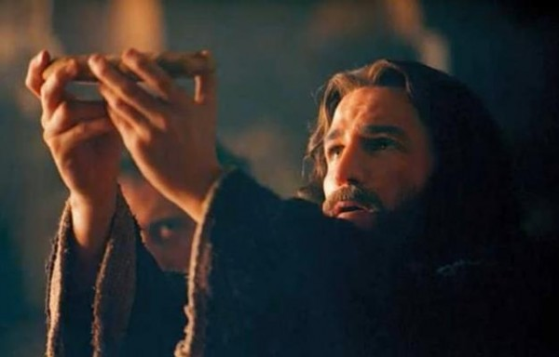
The Body of CHRIST
Communion with Jesus
One Body
Christ as the Head
Bride of Christ
The New Temple
Communion of Saints
Notes:
Communion with Jesus:
John 15:4-5 - Abide in me and I and you… I am the vine and you are the branches
John 6:56 – “He who eats my flesh and drinks my blood abides in me, and I in him”
John 14:18 – I will not leave you desolate; I will come to you
One Body
1 Cor 12:26 – “If one member suffers, all suffer together; if one member is honored, all rejoice together. Now you are the body of Christ and individually members of it. 28 And God has appointed in the church first apostles, second prophets, third teachers, then workers of miracles, then healers, helpers, administrators, speakers in various kinds of tongues. 29 Are all apostles? Are all prophets? Are all teachers? Do all work miracles? 30 Do all possess gifts of healing? Do all speak with tongues? Do all interpret? 31 But earnestly desire the higher gifts.”
Christ as the Head:
Christ is the head of the body – unites our sufferings with his, provides for our growth
Christ as the head and the Church as the members – the whole Christ
Bride of Christ:
Paul speaks repeatedly about it
Revelation is soaked in nuptial overtones
Christ’s Passion is a nuptial ceremony: The anointing with expensive oils, entering Jerusalem like a king, sneaking to a Garden the night before to pray, the purple robe, the crown, etc.
Becomes one flesh through Holy Communion; marital union is but a sign or symbol of the true full communion with Christ and with each other in Heaven
The New Temple:
The old temple was destroyed and cannot be rebuilt (many attempts, all fail)
No high priest, no sacrifices, no more Yom Kippur rope turning white (40 years before the temple fell)
Holy Spirit now dwells in all the tabernacles and in our hearts when we are in a state of grace
2 Cor 6:16 – we are now temples of the Holy Spirit
Comes to dwell within us during Baptism, remains when we are in state of Grace
Communion of Saints:
We can pray for each other, offer sacrifices for each other, sanctify each other
This doesn’t stop when we die. Saints in heaven (i.e. “Church Triumphant”) continue to pray for us, though they cannot obtain any more merit
Only souls on Earth (i.e. “Church Militant”) can obtain merit from the deposit of merit and apply it towards the sanctification of another
Souls in Purgatory (i.e. “Church Suffering” or “Church Waiting”) can receive our prayers and are greatly aided by our intercession
Saints will all eventually be one body in the beatific vision in Heaven, sharing a communion so close and so full of love that it would kill us in ecstasy today if we experienced it

Slide 22
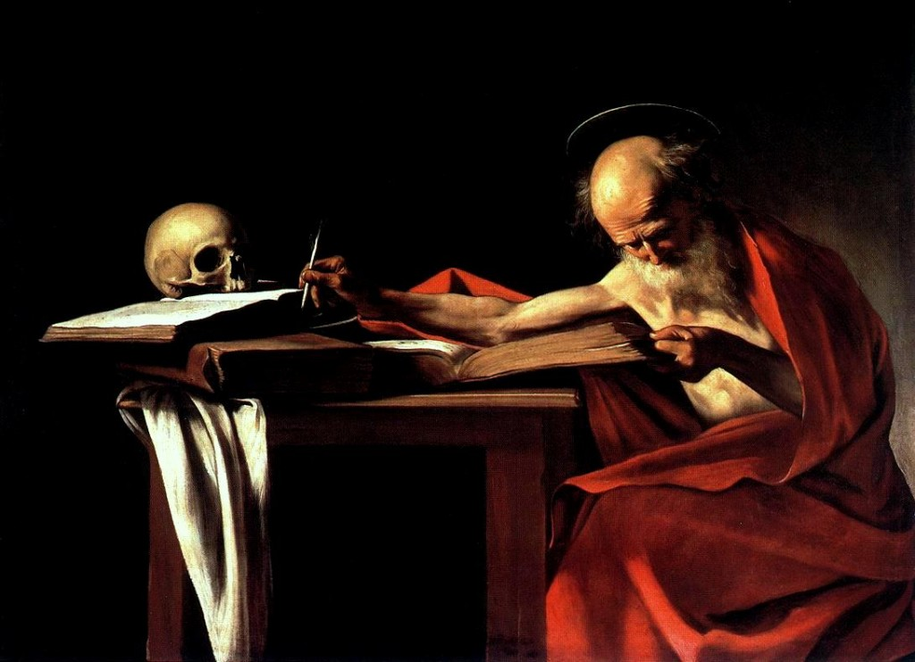
The Word of God
Notes:
First transmitted by Jesus by speaking to the Apostles and teaching (Sacred Tradition)
Apostles transmitted it to others by preaching and teaching
Eventually some of it was written down under the authority of the Apostles (Sacred Scripture)
Scripture is from the Church!

Slide 23
“Go into the whole world and proclaim the gospel to every creature. Whoever believes and is baptized will be saved; whoever does not believe will be condemned.”
- Mark 16:15-16
“Whoever listens to you listens to me. Whoever rejects you rejects me. And whoever rejects me rejects the one who sent me.”
- Luke 10:16
“Therefore, brothers, stand firm and hold fast to the traditions that you were taught, either by an oral statement or by a letter of ours.”
- 2 Thessalonians 2:15

Slide 24
ἀπόστολος (Apostle)
Transliteration: apostolos
English: Apostle
Definition:
A messenger, envoy, delegate, one commissioned by another to represent him in some way
Notes:
Apostle is someone sent as a delegate on behalf of, and with the authority, of the one who sent

Slide 25
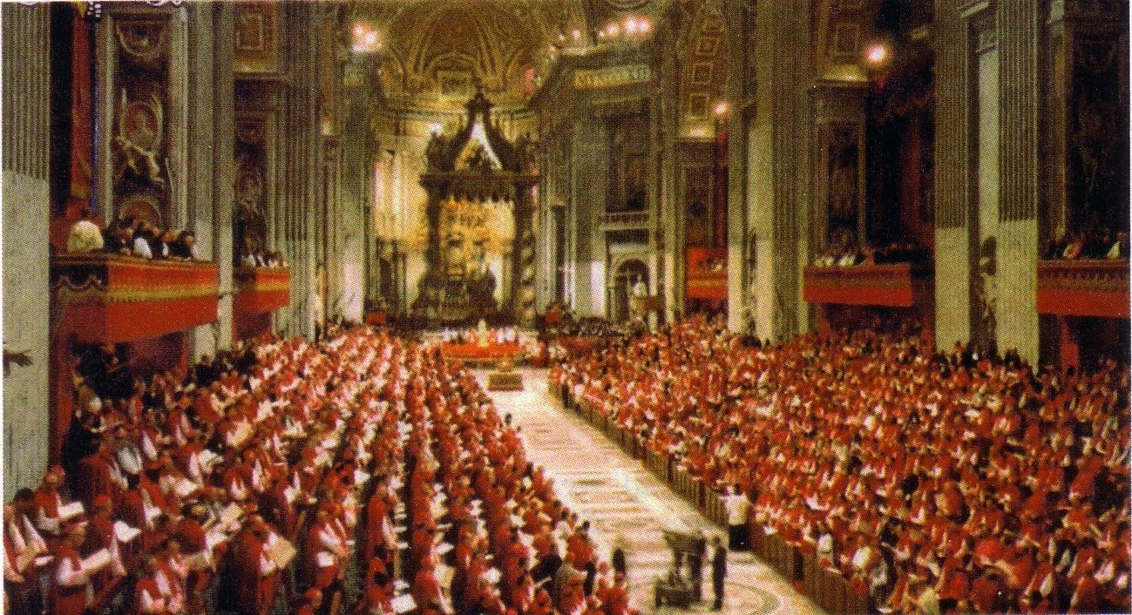
Tradition and Apostolic Authority
Seat of Moses
Keys to Loose and Bind
Infallibility
Magisterium
Dogma, Doctrine, and Discipline
Notes:
Seat of Moses: Living authority is not new, the Jewish leaders taught from the Seat of Moses in similar fashion to how the Pope and the Bishops function today (Mt 23:2-3)
Keys to Loose and Bind are also not new, practical and symbolic as delegated authority (Is 22:22)
Infallibility: Christ promised Holy Spirit to Guide the Successors of Peter and prevent from error (Mt 16:18, 28:20)
Magisterium: Teaching authority of the Church, “Magister” = teacher
Dogma, Doctrine, Discipline: Dogma and doctrine cannot be abrogated once defined, discipline can (bind/loose)

Slide 26
CONCLUSION
Pray
Sacraments
Read Scripture
Read the Church Fathers
The Church “forcefully and specifically exhorts all the Christian faithful … to learn ‘the surpassing knowledge of Jesus Christ,’ by frequent reading of the divine Scriptures. ‘Ignorance of the Scriptures is ignorance of Christ.’ ”
~ CCC 133

Slide 27
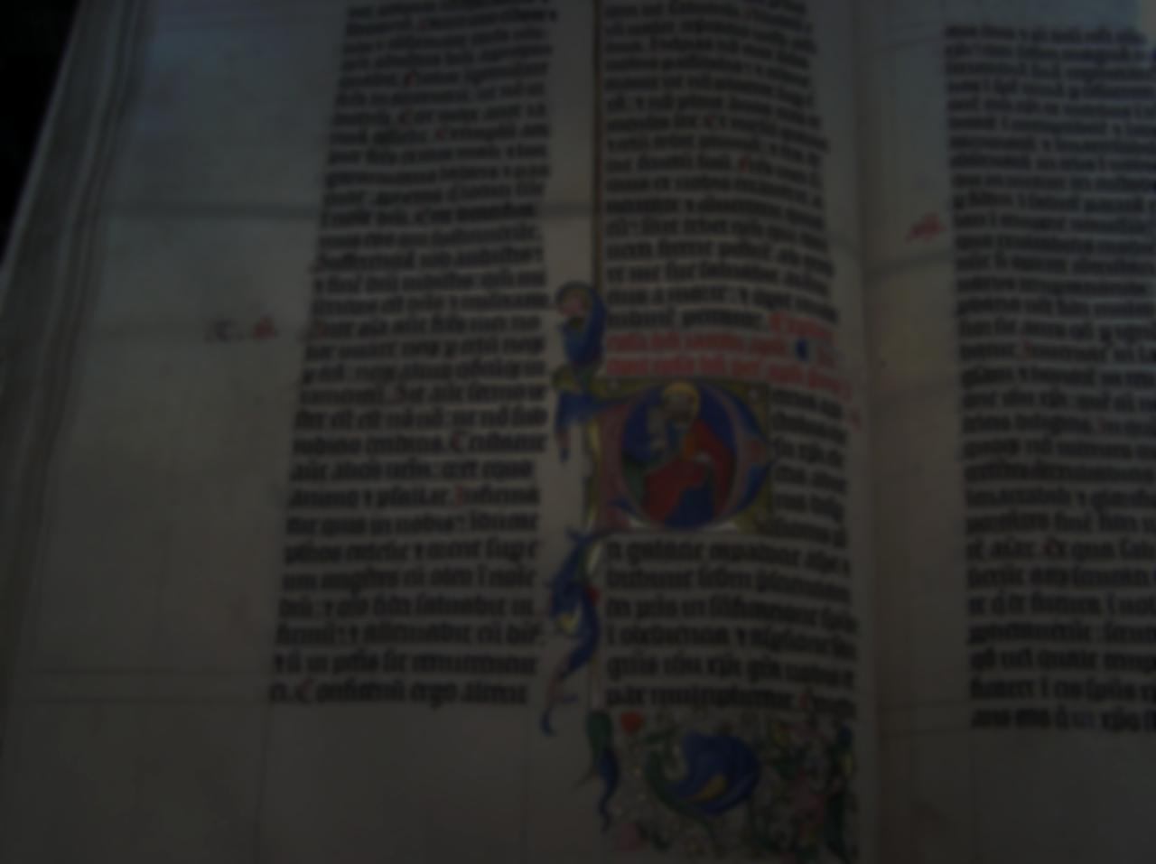
Sacred SCRIPTURE
A super brief history of the Bible:
Development of Canon
Rejected holy Documents
Apocrypha
Vulgate
Synods of Hippo and Carthage (A.D. 393-419)
Council of Florence – A.D. 1442
Council of Trent – A.D. 1546 – infallibly defined
Notes:
History of scripture:
Many documents written by Apostles, disciples, and their assistants.
Churches recognized them as holy and read them as part of Mass and other liturgies.
Eventually the writers died and Churches stopped considering new writings as Scripture.
Different Churches had different groups of documents, but most had mostly the same.
Eventually conflicts arose and so the Church had a number of councils and settled on a specific set of writings as Scripture.
Several books rejected from canon (Shepherd of Hermas, Didache, Epistle of Barnabas, Letter of Clement to the Corinthians, Polycarp’s letters)
Synods of Hippo and Carthage (A.D. 393-419), Council of Carthage (419), various decrees of Popes (Damasus, Adrian I, Innocent I, for example)
Latin Vulgate and St. Jerome
Council of Florence – A.D. 1442
Council of Trent – A.D. 1546 – Infallibly defined canon - in response to Luther and Protestant revolt
Sacred Scripture
Brief history
Many documents written and circulated, used at M____ by churches who considered them inspired
Apostolic writers died, churches stopped considering new texts inspired
Different churches had different sets of documents, but mostly the same
Church eventually had define canon when conflicts arose
Many bad texts rejected as apocryphal, some holy documents rejected as not inspired, but holy
Shepherd of Hermas
Didache
Epistle of Barnabas
Letter of Celement to the Corinthians
Polycarp’s Letters
Psuedo-Clementine Letters
Latin V____ was fairly definitive, but caused controversy later
C____ established at Synods of Hippo and Carthage (A.D. 393-419), various papal decrees (e.g. Damasus)
Formally defined at Council of F______ A.D. 1442
Infallibly defined at Council of T_____ A.D. 1546 in response to Protestant challenges
Usefulness of Scripture – 2 Tim 3:16-17, CCC 104 and 133

Slide 28
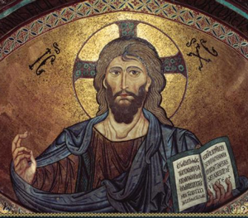
Usefulness of Scripture
All scripture is inspired by God and profitable for teaching, for reproof, for correction, and for training in righteousness, 17 that the man of God may be complete, equipped for every good work.
2 Tim 3:16-17

Slide 29
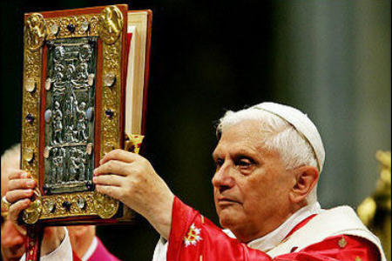
Sacred SCRIPTURE
In Sacred Scripture, the Church constantly finds her nourishment and her strength, for she welcomes it not as a human word, “but as what it really is, the word of God.” “In the sacred books, the Father who is in heaven comes lovingly to meet his children, and talks with them.“
~ CCC 104

Slide 30
SENSES OF SCRIPTURE
Literal (not literalistic!)
Spiritual
Allegorical
Moral
Anagogical
But I would not believe in the Gospel, had not the authority of the Catholic Church already moved me.
~ St. Augustine of Hippo A.D. 397
Notes:
Literal: The meaning being conveyed by the author, discovered by exegesis following the rules of sound interpretation
Allegorical: Red sea prefigures Christ’s passion and also baptism, Ark of Covenant prefigures Mary,
Moral: Now these things happened to them as a warning, but they were written down for our instruction – 1 Corinthians 10:11
Anagogical: “anagoge” – Greek for “leading” – view realities in terms of their eternal significance (i.e. the Church on Earth is a sign of the heavenly Jerusalem)
For, of course, all that has been said about the manner of interpreting Scripture is ultimately subject to the judgment of the Church which exercises the divinely conferred commission and ministry of watching over and interpreting the Word of God. – Dei Verbum

